Slide 1
Inquiry Project
How to teach essay writing:
Tips & Tricks

Slide 2
Using Computers:
"Initial Effects of Word Processing on Writing Quality and Writing Quality of Freshman Writers" - Milton Teichman and Marilyn Portis

Slide 3
Tips & Tricks
They may not always do better but students tend to put in more effort on a computer than they do on paper.
Student's write more, are more enthused, and typical do more work when using word processing programs to write.
Student's rarely edit paper drafts because the process is far more difficult.
Computers allow them to do editing on the fly and integrate their outlines directly into the paper.

Slide 4
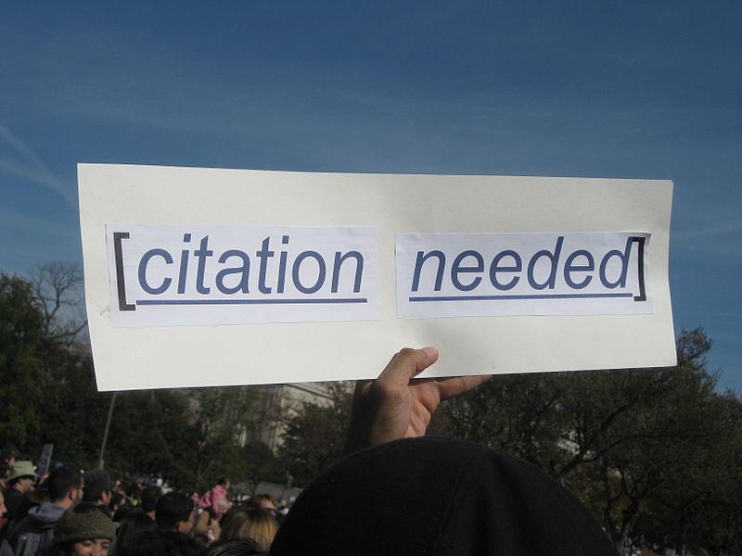
Style Guides
"Essay Writing: Do Study Manuals Give Relevant Advice?" - Pauline A. Mahalski

Slide 5
Tips & Tricks
Most students finish essays the day before they are due with only 1/3rd edited. The average length of their papers is the exact length you give them.
Students are often very aware of the structure of an essay, the styles they should be using, and what is necessary in a major paper.
Spoilers: Unless you show them the importance of these aspects and model it for them, they are statistically proven to ignore most of these aspects.
A common misconception is preparation time has a major correlation with grades.
This is entirely dependent on the student.

Slide 6
Tips & Tricks
Outlines are a very important practice as they help students focus their ideas.
A large issue students have is they do not answer the question or stay focused within their essay. An outline keeps them focused.
Use an organizer such as the one found on readwritethink if students are struggling.
http://www.readwritethink.org/classroom-resources/student-interactives/essay-30063.html
Following a style guide provides far better results for students, such as a checklist for the components of an essay; however, you should make the checklist a component they need to hand in otherwise they have a tendency to ignore them.

Slide 7
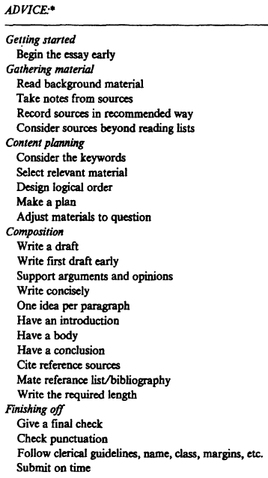
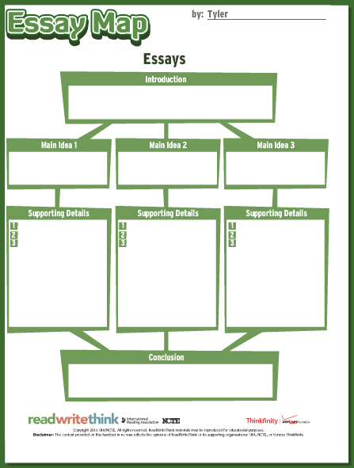

Slide 8
Peer Editing
"Structured Peer Collaboration: Teaching Essay Revision to College Students Needing Writing
Remediation" - Kimberly Kinsler

Slide 9
Tips & Tricks:
Setting up peer editing groups improves the quality of students writing.
Requiring peer editing actually forces the students to think about editing and put more effort into their paper because they acknowledge other students are going to see their writing.
Peer editing hits multiple outcomes and facilitates student interactivity.
http://jimmiescollage.com/downloads/writing/peer-editing.pdf

Slide 10
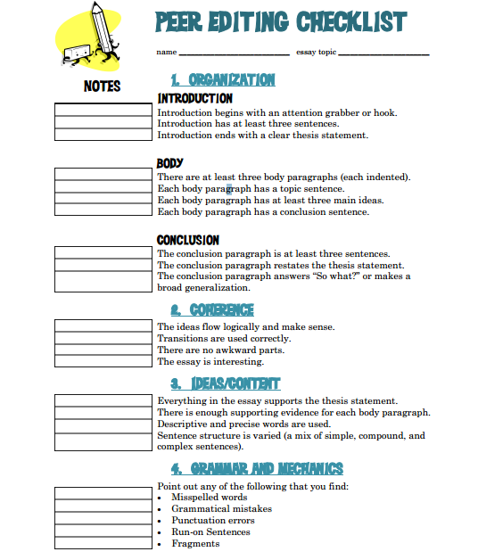

Slide 11
Essay Topics:
"Student Characteristics and Essay Test Writing Performance" - Sarah Warshauer Freedman

Slide 12
Tips & Tricks:
Students respond worse to responding to quotes from novels than they do from topical questions.
Students are more confident when they are writing on topics that they find interesting.
If a topic is interesting students do not find it difficult; however topics that students deem uninteresting are far more difficult to write on and students tend to do worse.

Slide 13
Response Journals:
"Effects of Guided Journal Writing on Students' Story Understanding" - Bernice Y. L. Wong, Sonia Kuperis, Dianne Jamieson, Lois Keller and Robin Cull-Hewitt

Slide 14
Tips & Tricks
Getting students to respond to texts often increases their understanding of the text because it forces them to reconsider what they read.
Forces students to think about the meaning of the text instead of just focusing on the literal interpretation of the text.
Allows for discussion that will lead to students finding topic they can use for their essay writing.

Slide 15
THE END
Tyler MacIntosh

